Slide 1
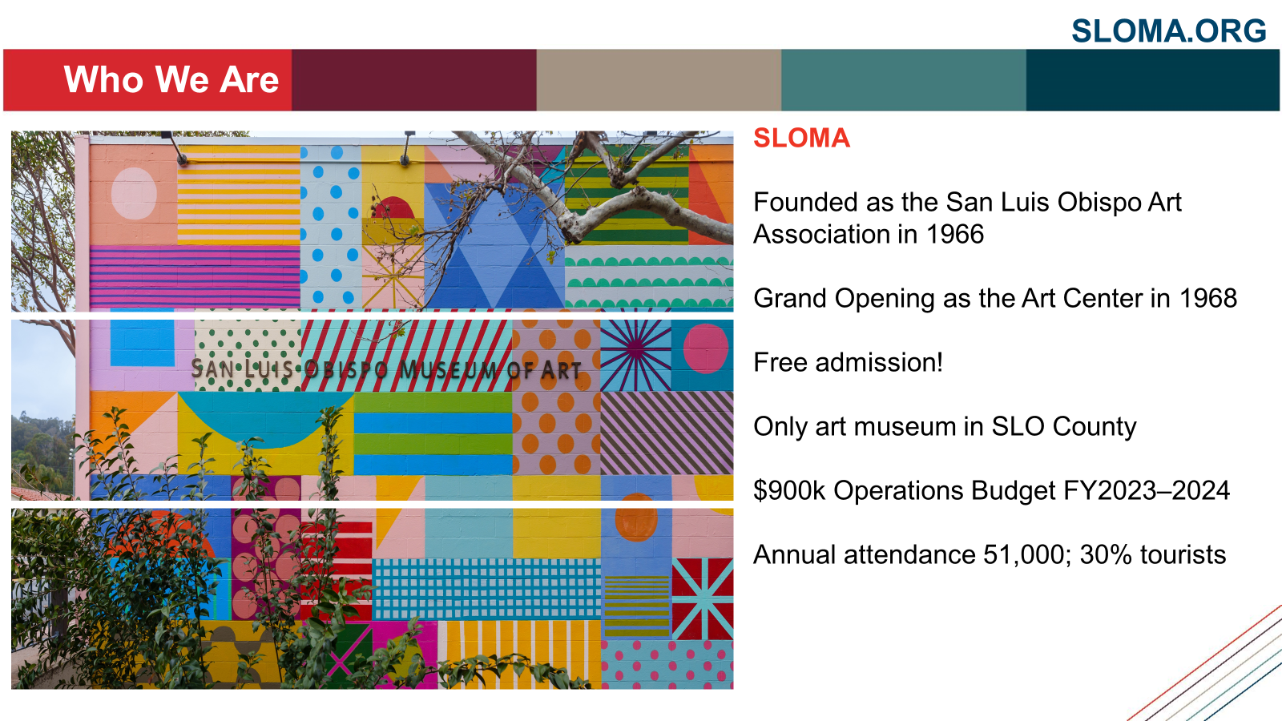

Slide 2
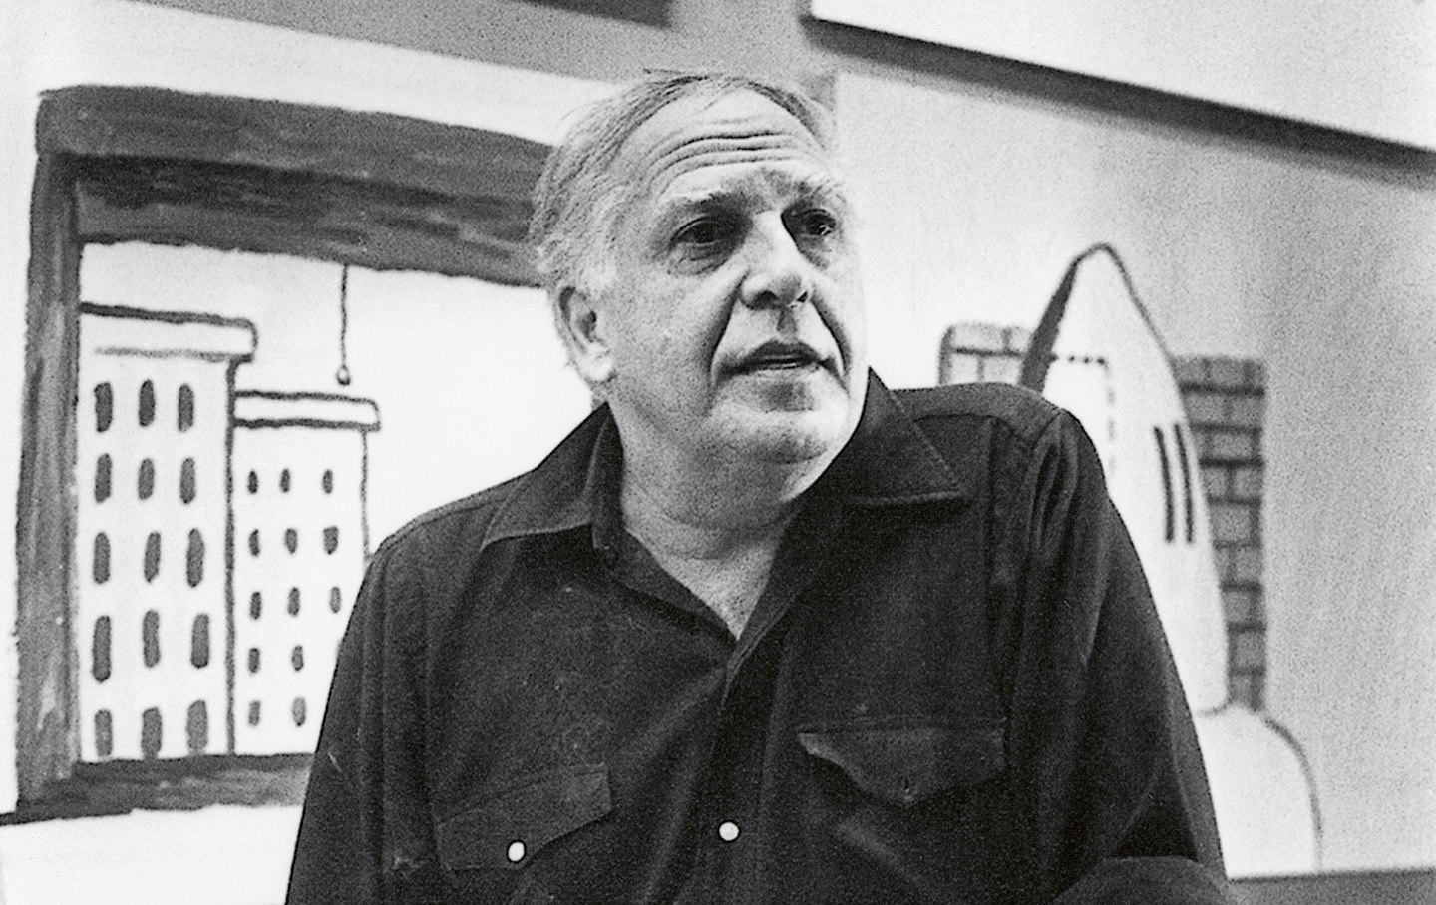

Slide 3
Philip Guston
1913 – Born in Montreal, Canada; raised in Los Angeles.
1934–35 – Paints Mexican fresco The Struggle Against Terrorism
1935 – Joins WPA Mural Division in New York
1945 – Wins Prix de Rome (The Rome Prize); studies Renaissance art in Italy 1950s – Becomes a leading Abstract Expressionist in New York
1970 – Shocks critics with return to figuration (cartoon imagery, everyday symbols)
1973 – Begins teaching at Boston University
1980 – Dies in Woodstock, New York.
2003 – Major retrospective at The Met cements legacy.
2020–24 – Philip Guston Now retrospective travels to U.S. & U.K.

Slide 4
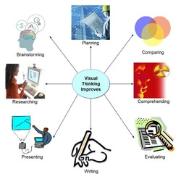
Visual Thinking Strategies:
What is going on in this picture?
What do we notice?
What do we like?
What do we dislike?
What feelings emerge from looking at this work?
What are some formal qualities we see - color, shape, line, composition?
Go deeper - what else is there?

Slide 5
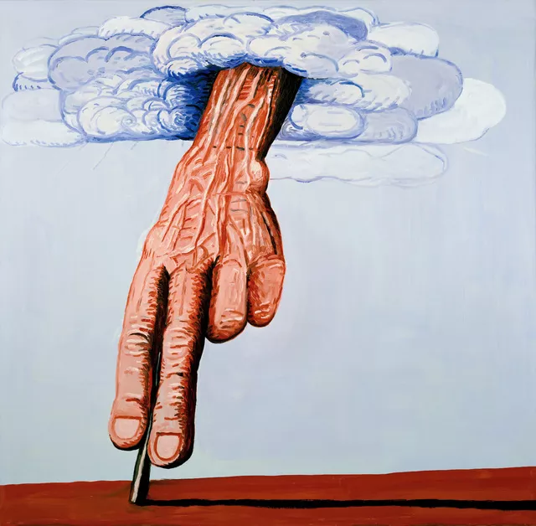

Slide 6
The Line, 1978
Oil on canvas
71 × 73 3/10 in | 180.3 × 186.1 cm

Slide 7
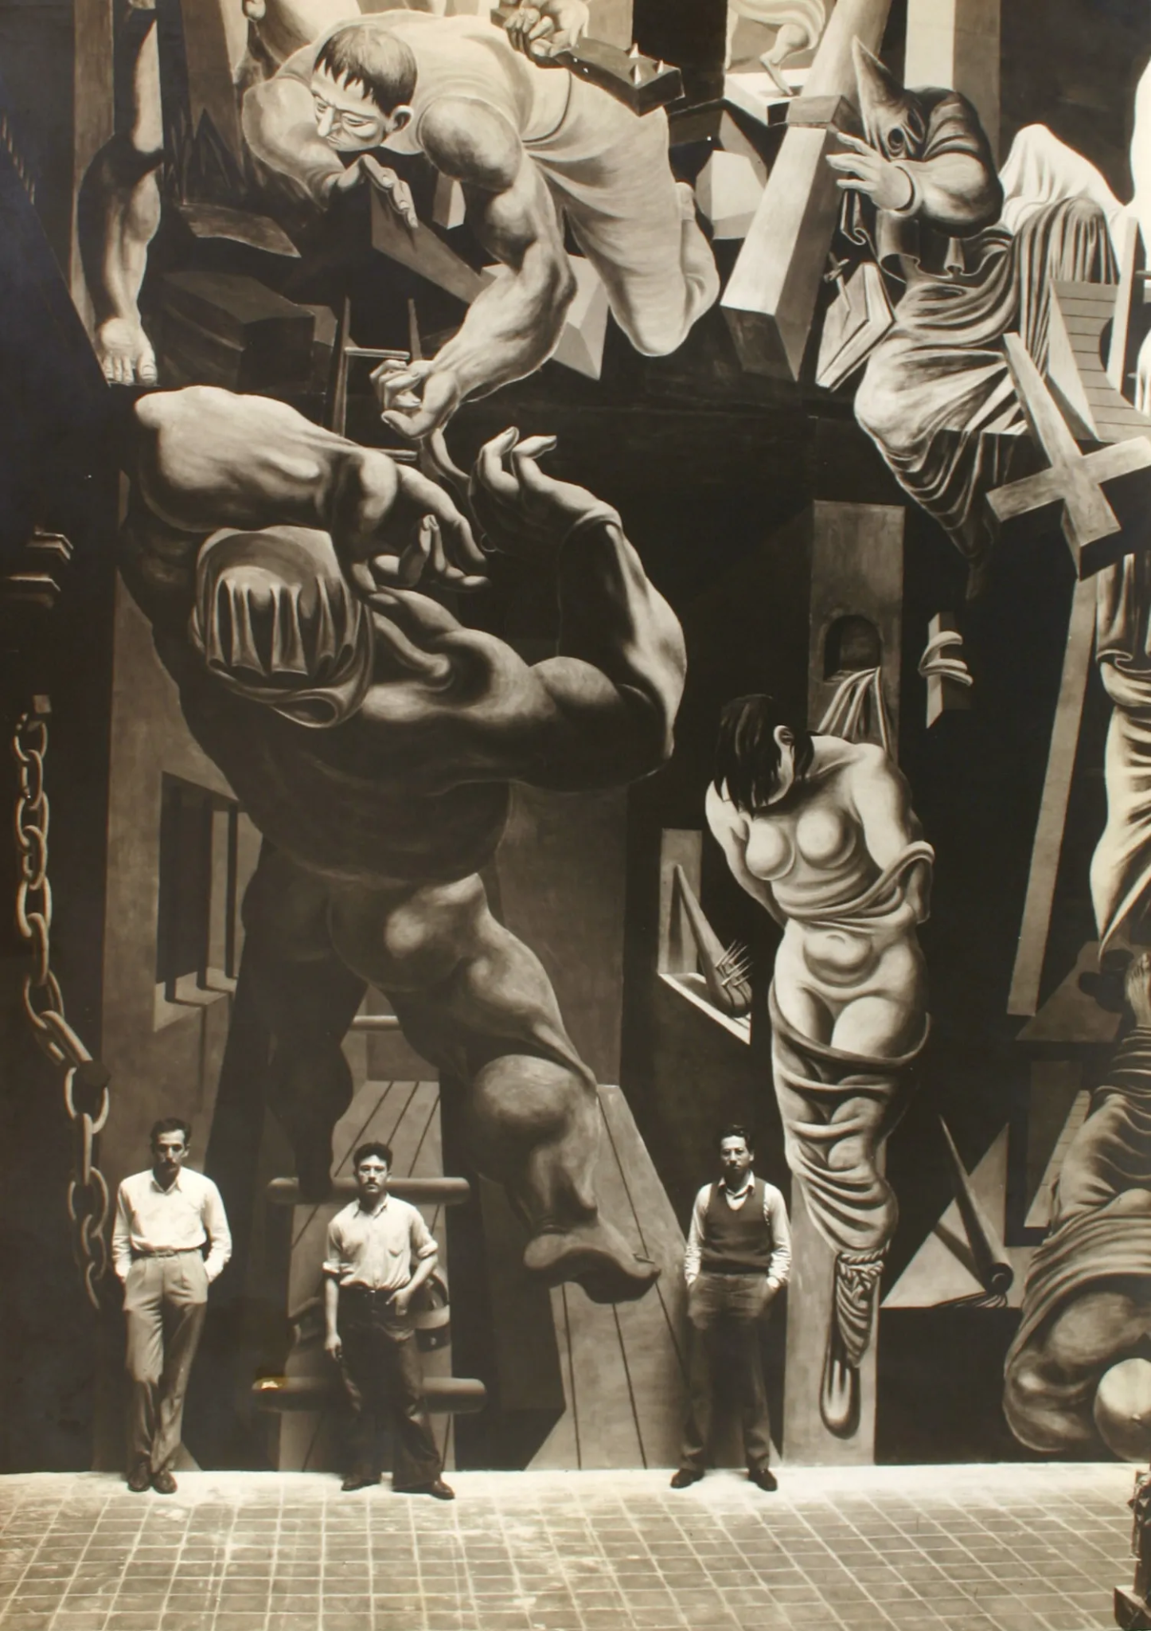
Philip Guston, Reuben Kadish and friend Jules Langsner in front of the mural, ‘The Struggle Against Terrorism,’ ca. 1934

Slide 8
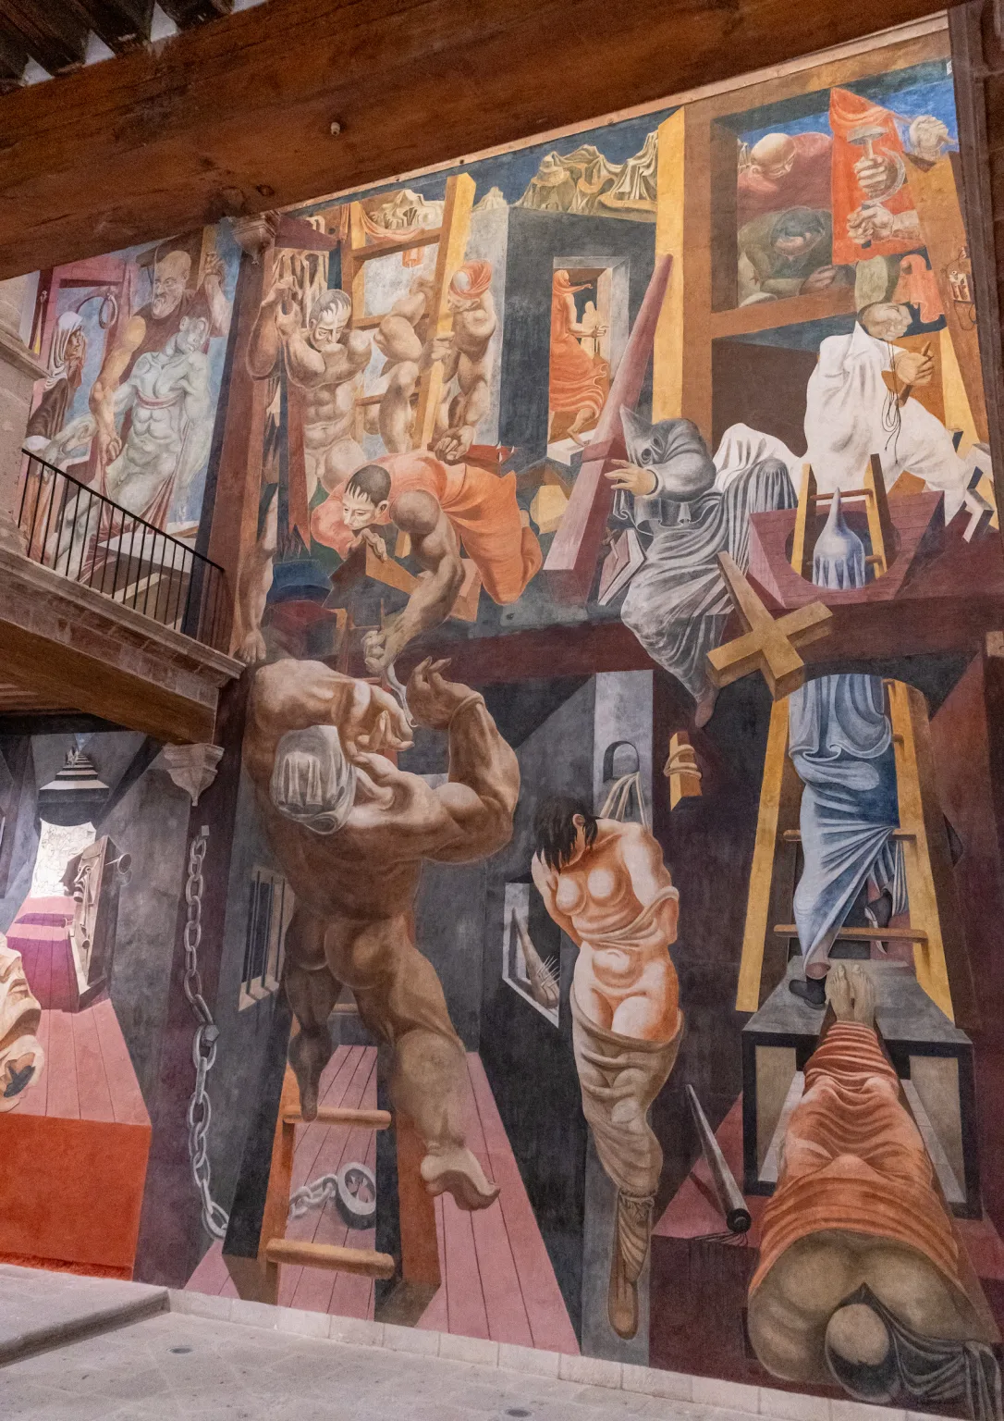
Often in art history, we only have part of the image, and therefore part of the story! The field is made up of scholars who are trying to put those pieces together

Slide 9
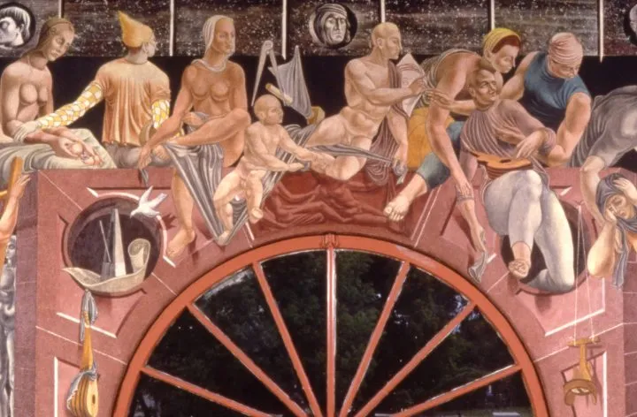
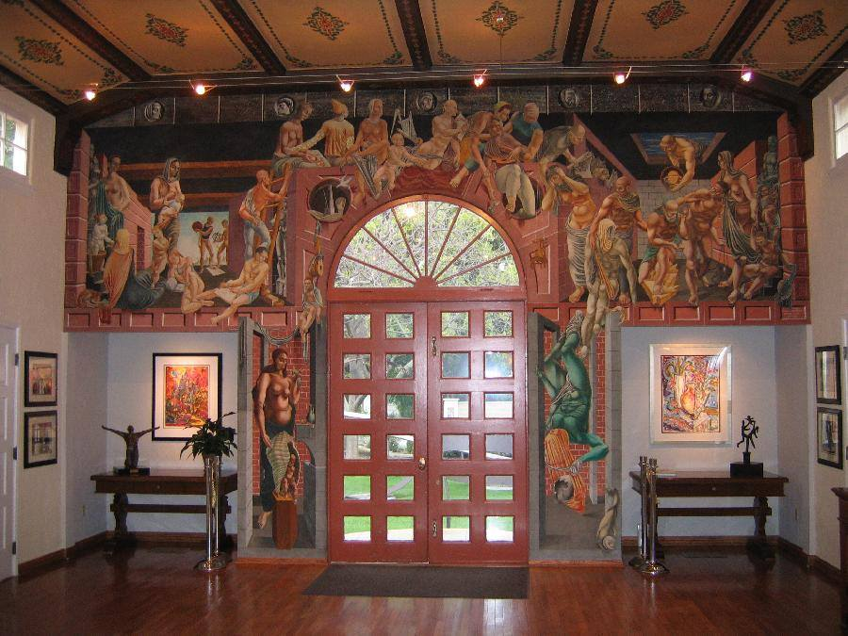
Philip Guston and Reuben Kadish, “Physical Growth of Man” (Detail) (1936)

Slide 10

The Works Progress Administration (WPA) supported art through the Federal Art Project (FAP), a government program that employed artists to create public art, teach, and promote art during the Great Depression. It provided jobs for thousands of artists, produced thousands of murals and posters for public buildings and community programs, and established over 100 art centers across the nation, leading to a significant body of artwork and the later creation of the National Foundation of the Arts.

Slide 11
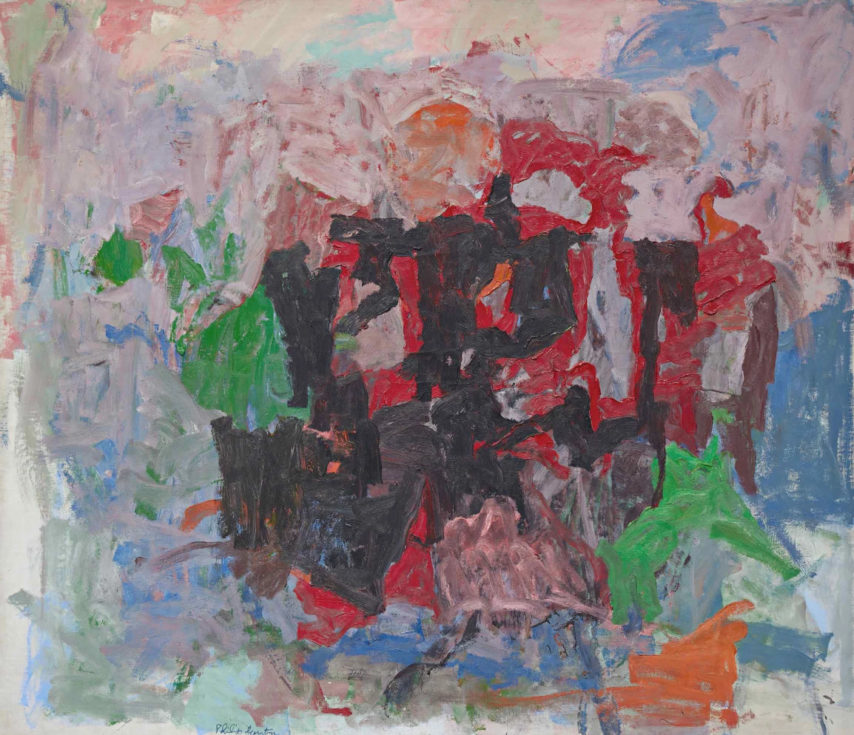
Philip Guston’s Nile,
Painted in late 1958s

Slide 12
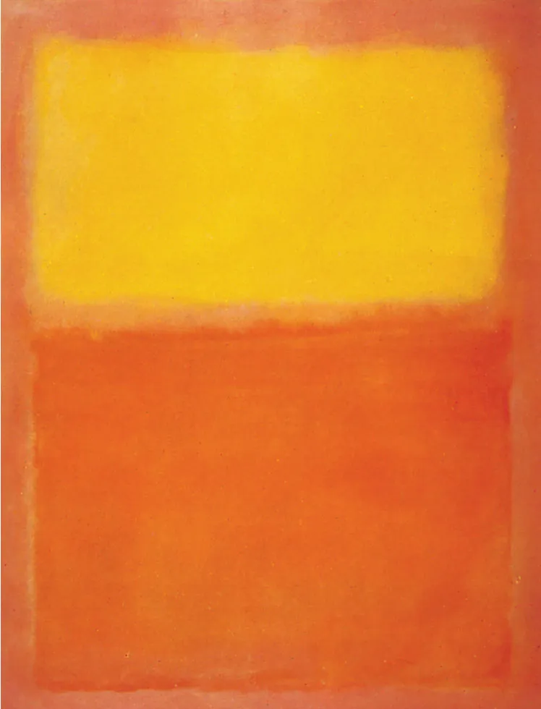
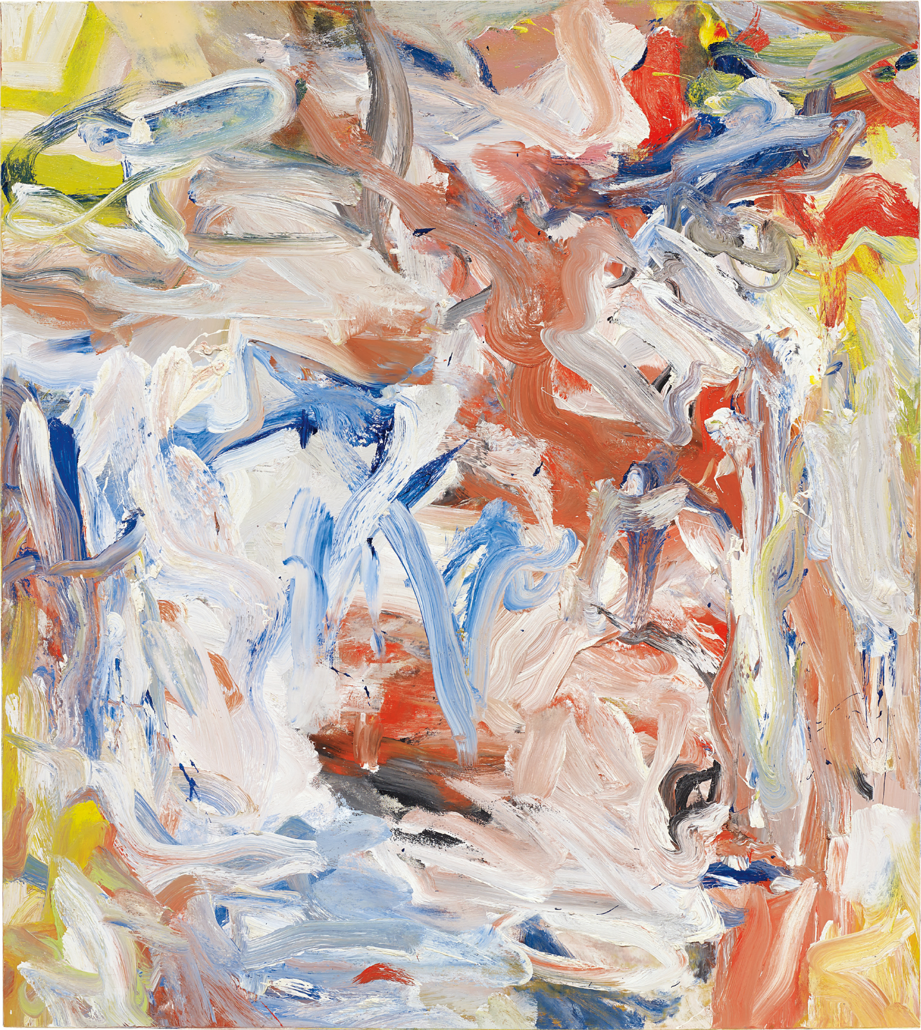
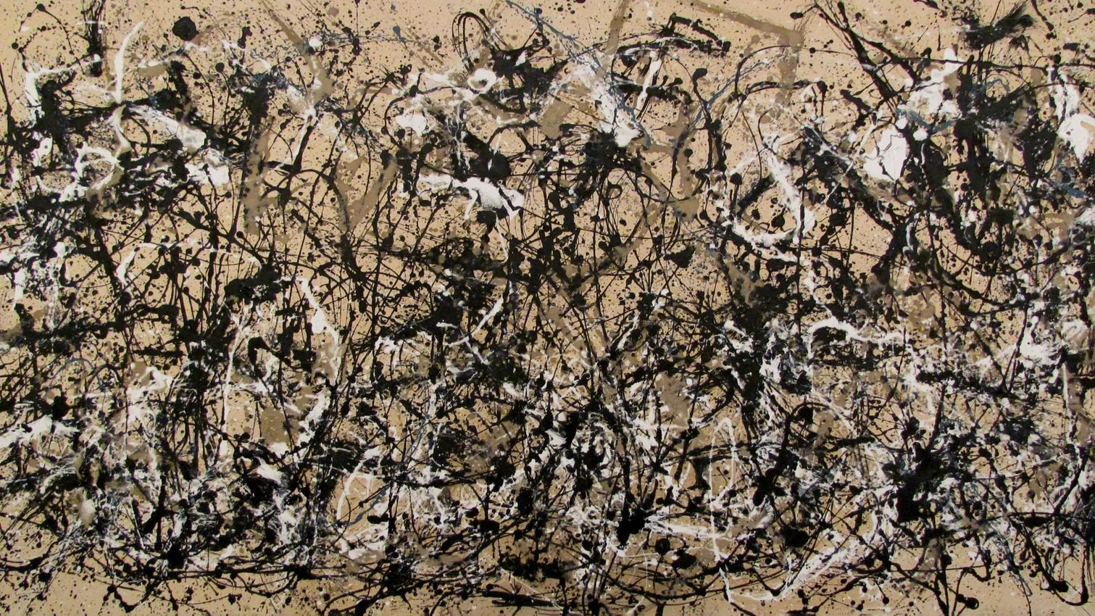
Abstract Expressionism was an art movement that started in New York in the 1940s and 1950s. Instead of painting realistic people, places, or objects, artists focused on showing their feelings, ideas, and energy through the way they used paint.
The paintings are often large, with bold brushstrokes, drips, splatters, or big fields of color.
The goal wasn’t to copy the real world, but to make the act of painting itself a way of expressing emotions—like anger, joy, or chaos.
Famous artists include Jackson Pollock (drip paintings), Mark Rothko (big glowing rectangles of color), and Willem de Kooning (wild, energetic brushwork).
In short: Abstract Expressionism is about emotion over realism, and energy over detail.

Slide 13
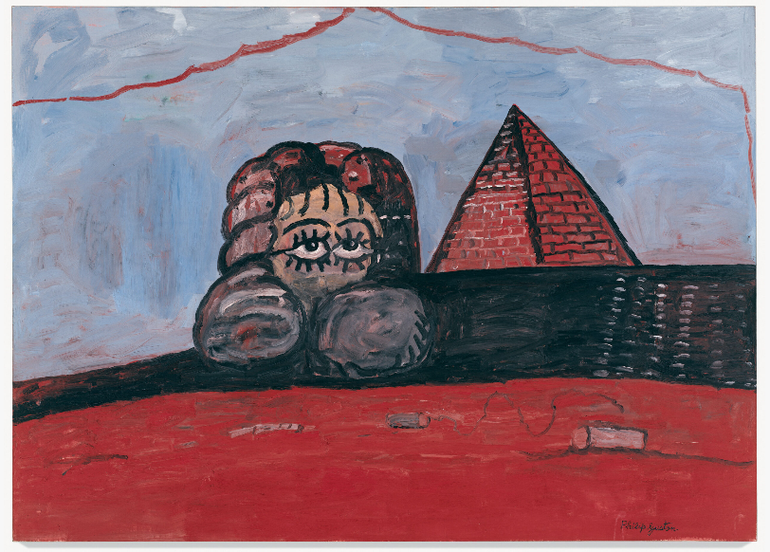
Philip Guston Nile, 1977

Slide 14
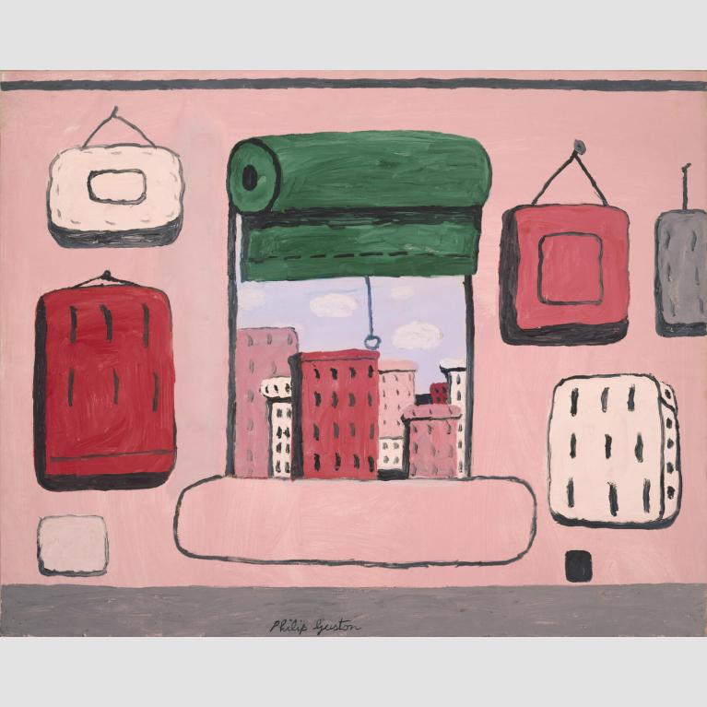
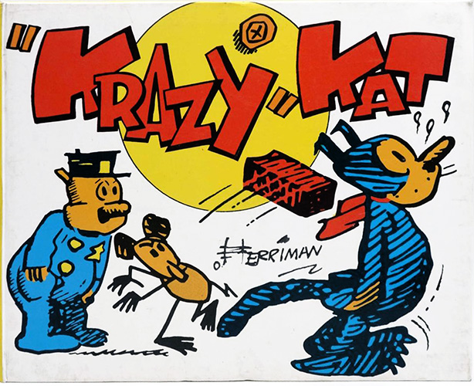

Slide 15
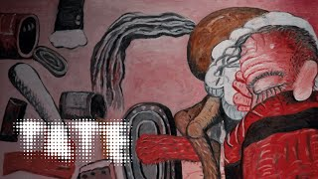

Slide 16
Questions for the Class:
How does Guston’s move from Abstract Expressionism to figurative, cartoon-like imagery challenge expectations of modern art at the time?
What effect does Guston achieve through his use of simple, almost childlike forms and a limited color palette?
How does Guston’s work compare to other mid-20th century artists you’ve studied in terms of style, subject matter, or approach to abstraction and figuration?
What role do everyday objects (shoes, clocks, light bulbs, cigarettes, bricks) play in shaping the meaning of his paintings?
In what ways do Guston’s paintings reflect both personal expression and broader cultural or historical concerns?

Slide 17


This presentation was created through the support of

